Slide 1
Topology and Shape Optimization:
Achievements and New Frontiers
State-of-the-Arts in WCSMO-11
Qing Li
School of Aerospace, Mechanical and Mechatronic Engineering,
The University of Sydney, NSW 2006, Australia
Notes:
First of all I would like to thank to International Paper Committee who trusted me and gave me this opportunity. It is my privilege to give this presentation in SOTA. To be honest, I feel bit nevrous to talk about state-of-the-arts in topology optimization for two reasons, first there are so many pioneers of modern topology optimization in this room and in front of such many top experts, my talk may probably not be easy to touch the critical points. Second, there are so many topology/shape optimisation papers spaning from truss to 3D, compliance to electrical permittivity, aerospace to civil in this congress, which forced us to form 25 parallel sessions over the four days of conference. It is not easy for me to cover such a broad topic and so many excellent papers/presentations. If I miss any critical points, please feel free to comment in the end. Fortunately, our chair and colleagues in this panel will correct and supplement my talk.

Slide 2
Agenda
Topology and shape optimisation in recent WCSMO.
Algorithmic aspects
Stress criteria
Thermofluids
Multiscale problems
Metamaterials
Energy harvest (wind, solar, radiation etc)
Biomedical engineering
Additive manufacturing

Slide 3
Agenda
Topology and shape optimisation in recent WCSMO.
Algorithmic aspects
Stress criteria
Thermofluids
Multiscale problems
Metamaterials
Energy harvest (wind, solar, radiation etc)
Biomedical engineering
Additive manufacturing

Slide 4
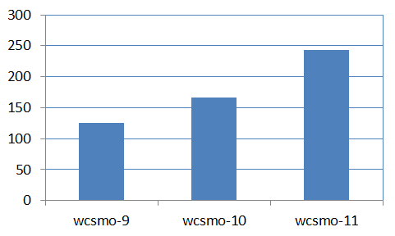
Topology and Shape Optimization papers in the past three WCSMOs
25 parallel sessions
243 (70%)
14 parallel sessions
167 (45%)
125 (50%?)
Personal counts

Slide 5
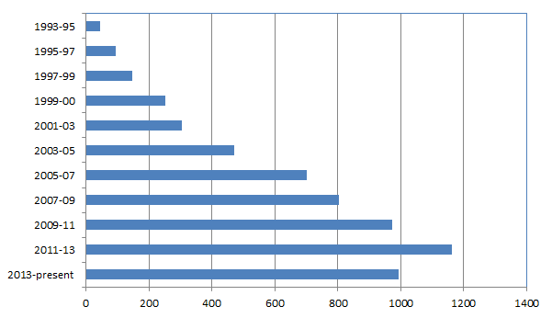
Number of papers in “Topology Optimization”
(Source: Web of Science – all databases)
WCSMO-1
WCSMO-2
WCSMO-3
WCSMO-4
WCSMO-5
WCSMO-6
WCSMO-7
WCSMO-8
WCSMO-9
WCSMO-10
WCSMO-11
(As of 6 June 2015)

Slide 6
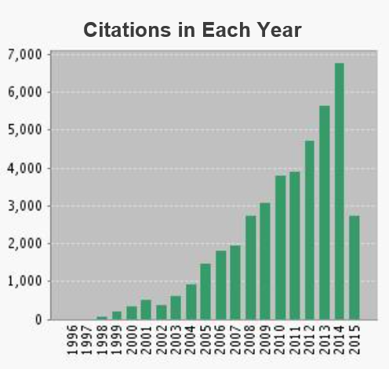
Citations in the topics of “Topology Optimization” over the last 20 years
As of 6 June 2015

Slide 7
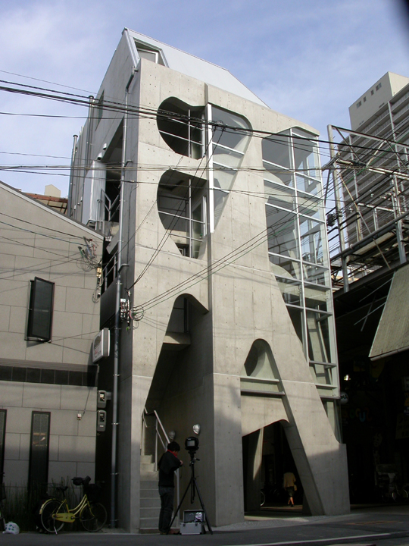
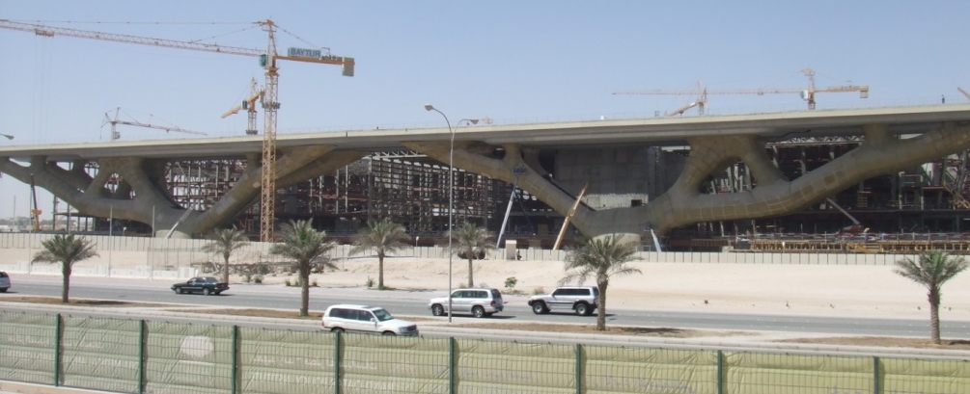
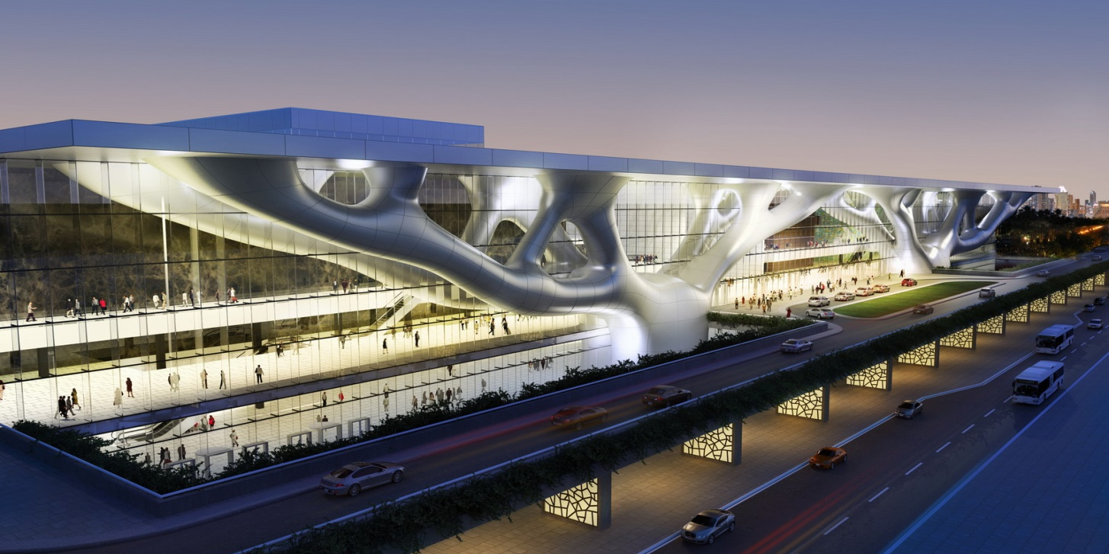
Some Real-Life Applications
Building design
Qatar Convention Centre
(Xie et al #1197)

Slide 8
Agenda
Topology and shape optimisation in recent WCSMO.
Algorithmic aspects
Stress criteria
Thermofluids
Multiscale problems
Metamaterials
Energy harvest (wind, solar, radiation etc)
Biomedical engineering
Additive manufacturing

Slide 9
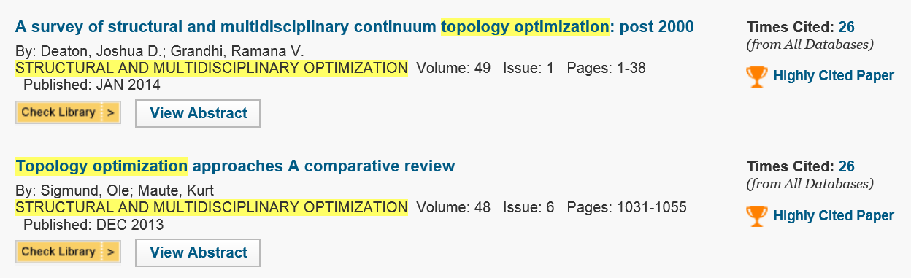
Algorithmic aspects
Density based (SIMP) – mathematical programming
Density based (Hierarchical – ESO/BESO)
Boundary based (Level-Set or other implicit methods)
Others

Slide 10
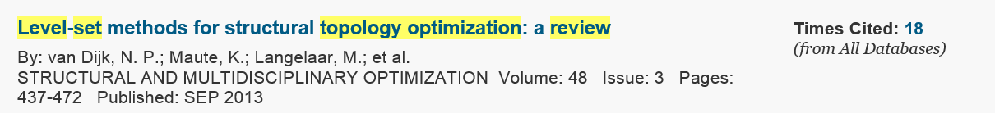
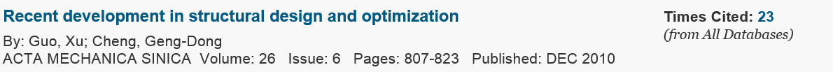
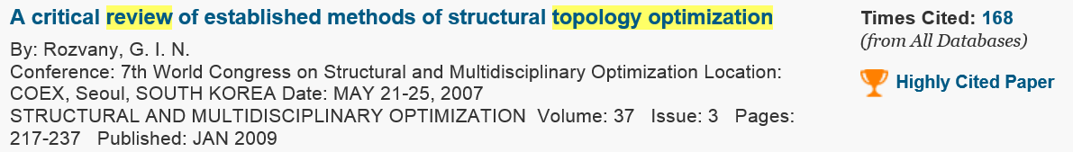
Recent review of literature

Slide 11
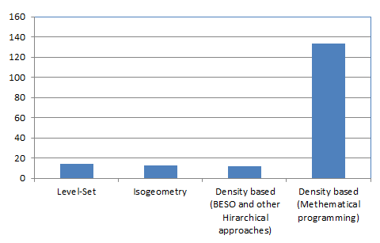
Algorithmic distribution (as described in the papers)

Slide 12
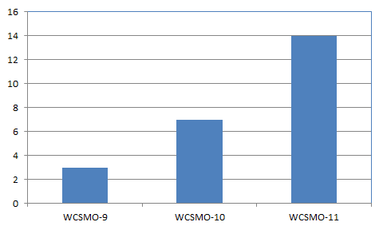
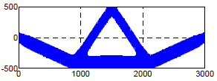
Isogeometry based Topology and Shape Optimization
Geometric nonlinearity
(Tong and Luo #1406)

Slide 13
Agenda
Topology and shape optimisation in recent WCSMO.
Algorithmic aspects
Stress criteria
Thermofluids
Multiscale problems
Metamaterials
Energy harvest (wind, solar, radiation etc)
Biomedical engineering
Additive manufacturing

Slide 14
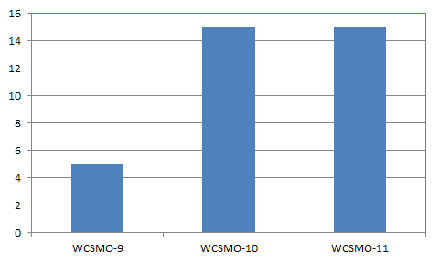
Topology and Shape Optimization for Stress Criteria
Fracture
Fatigue
#1242 Pierre Duysinx Topology optimization of mechanical and aerospace components subject to fatigue stress constraints
#1145 Yusuke Naritomi Shape optimization for minimizing the KS function of von Mises stress using shape derivative of domain integral type
#1057 Kiyono, ECN Silve Topology optimisation for stress-based problems applied to laminated composite structures
# 1288 Amir An alternative approach for satisfying stress constraints in continuum topology optimization using nonlinear material modeling
#1274 Goo Structural topology optimization with eigenvalue and stress constraints using ANSYS

Slide 15
Agenda
Topology and shape optimisation in recent WCSMO.
Algorithmic aspects
Stress criteria
Thermofluids
Multiscale problems
Metamaterials
Energy harvest (wind, solar, radiation etc)
Biomedical engineering
Additive manufacturing

Slide 16
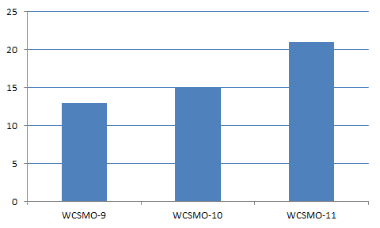
Topology and shape optimization in thermofluids

Slide 17
Topology and Shape Optimization for Thermofluids
Algorithms:
Bidirectional evolutionary structural optimization (BESO)
Level Set method + Lattice Boltzmann
Deformable Simplicial Complex (DSC)
Density based (SIMP) approaches.
Problems:
Stokes flow
Two-phase flow
Turbulent/unsteady flow
Thermo-fluid flow
Gas storage in porous medium
Heat exchange
Fluid-structure interaction
Reaction-diffusion

Slide 18
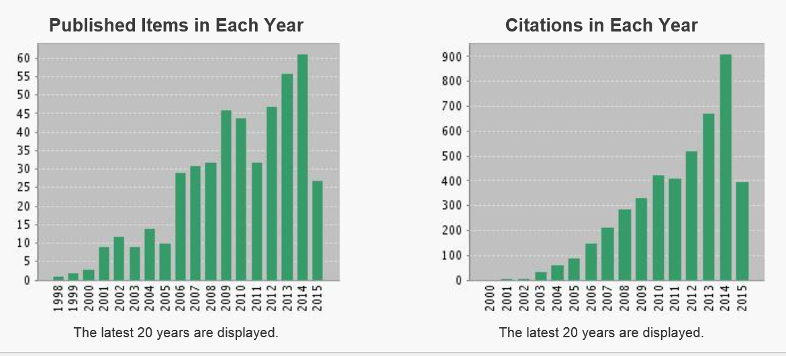
Topology optimization in thermofluids
465 articles on thermal and fluid problem published over the last 20 years

Slide 19
Agenda
Topology and shape optimisation in recent WCSMO.
Algorithmic aspects
Stress criteria
Thermofluids
Multiscale problems
Metamaterials
Energy harvest (wind, solar, radiation etc)
Biomedical engineering
Additive manufacturing

Slide 20
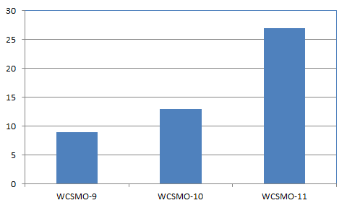
Topology Optimization for Multiscale Problems

Slide 21
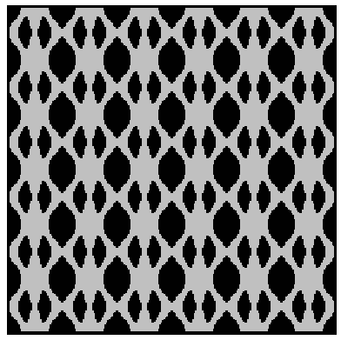
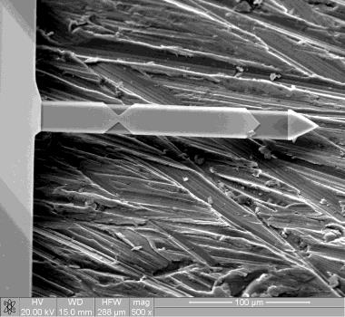
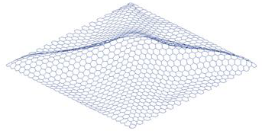

Examples of multiscale problems
Optimized graphene sheet
(Shi and Shimoda #1078)
Vibro-acoustic material
(Du and Sun #1064)
AFM cantilever
(Wang et al #1158)
Buckling property
Vibro-acoustic property
Hyperelastic property
Electro-osmosis
… …
Nano-scale structure (multi-frequency AFM)
Coupled cellular material and structures
Microfluids
… …

Slide 22
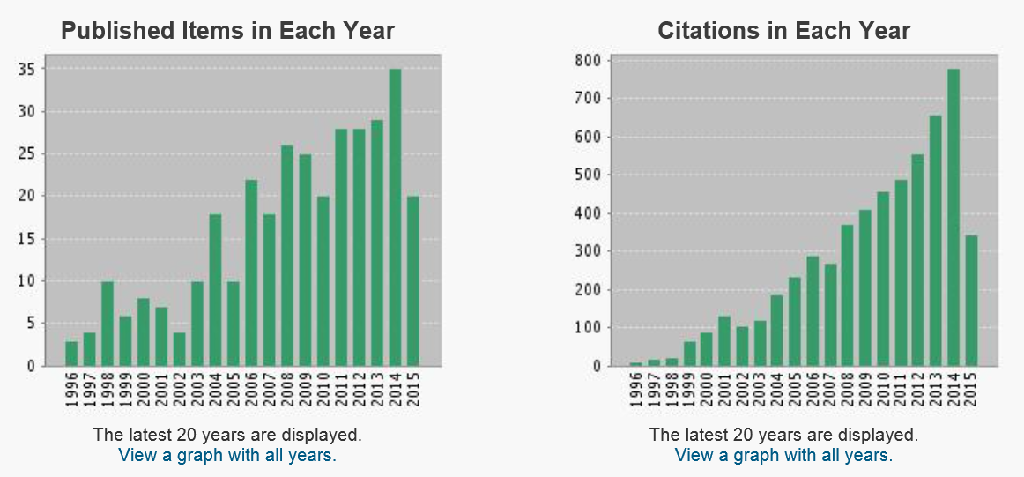
Publications in multiscale problems
385 articles on “multiscale problem” published over the last 20 years

Slide 23
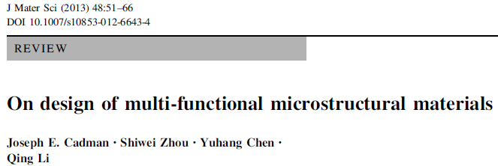
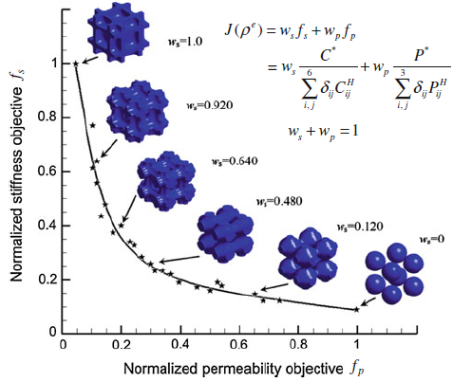
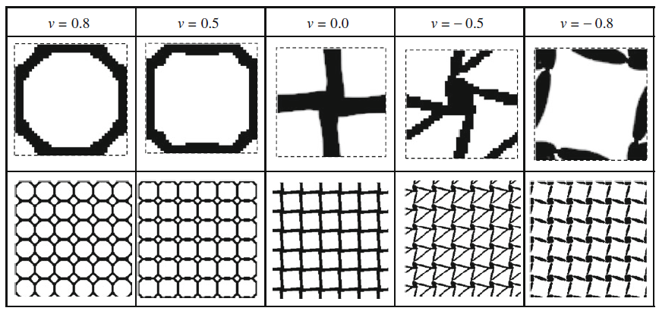
Periodic microstructural composites
Physical properties:
Stiffness/compliance
Poisson’s ratio
Thermal expansion coefficient
Conductivity
Permeability and diffusivity
Functionally graded materials
Competing properties
Phononics/photonics
Metamaterials

Slide 24
Agenda
Topology and shape optimisation in recent WCSMO.
Algorithmic aspects
Stress criteria
Thermofluids
Multiscale problems
Metamaterials
Energy harvest (wind, solar, radiation etc)
Biomedical engineering
Additive manufacturing

Slide 25
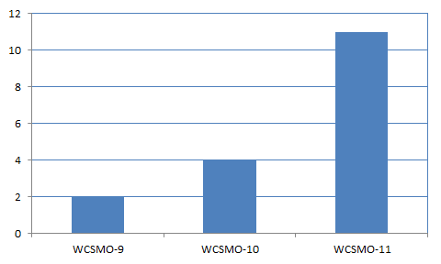
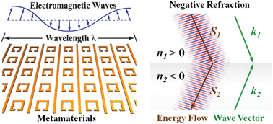
Topology/shape optimization for metamaterials
Metamaterials are materials engineered to have properties that have not yet been found in nature
Electromagnetics (negative refractive index)
Optics (nano-photonics)
Acoustics (elastic wave)
Negative Poisson’s ratio and Negative thermal expansion coefficient (elasticity)
Negative Young’s modulus and negative mass (acoustics)
Negative thermal conductivity and negative emissivity (radiation)
… …

Slide 26
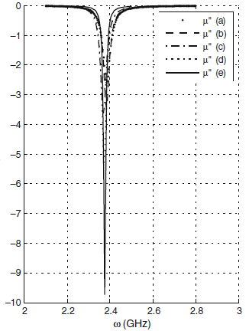
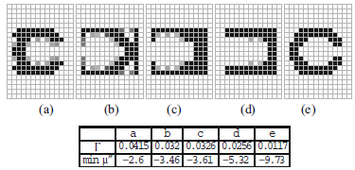
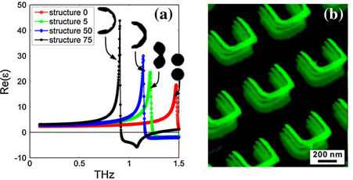
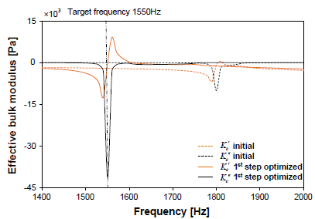
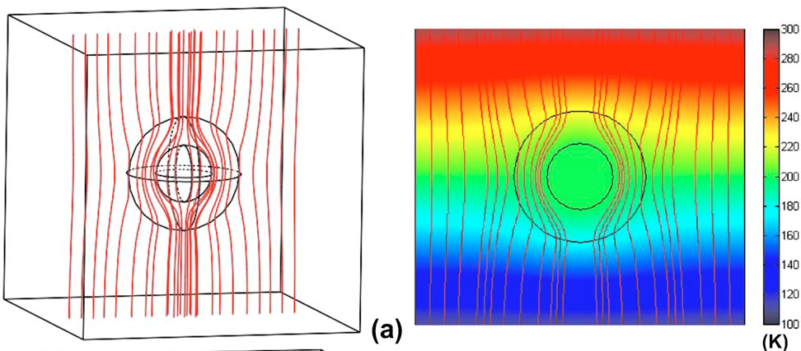
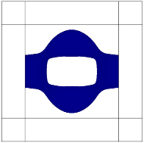
Examples of Topology optimization for metamaterials
negative magnetic permeability
Density based approach (SIMP + MMA)
(Diaz and Sigmund SMO 41 (2010):163–177)
Boundary based approach (Level-set)
(Zhou et al, Optics Express 2010)
Heat flux
Boundary based approach (Level-set)
(APL 92, 251907 (2008))
Boundary based approach (Level-set)
(Lu FEAD 72 (2013):1-12)

Slide 27
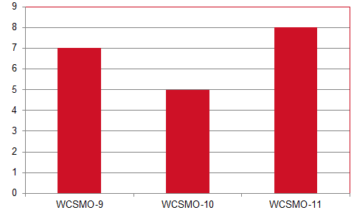
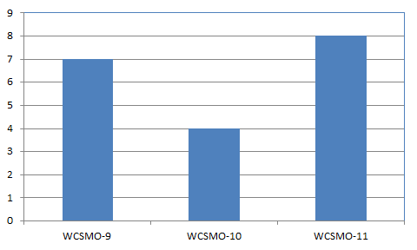
Topology and Shape Optimization in Other Areas
Photonics/phononics/plasmonics
Pizeoelectrics/Mechanics
Electromagnetics

Slide 28
Agenda
Topology and shape optimisation in recent WCSMO.
Algorithmic aspects
Stress criteria
Thermofluids
Multiscale problems
Metamaterials
Energy harvest (wind, solar, radiation etc)
Biomedical engineering
Additive manufacturing

Slide 29
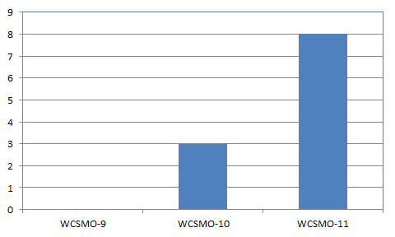
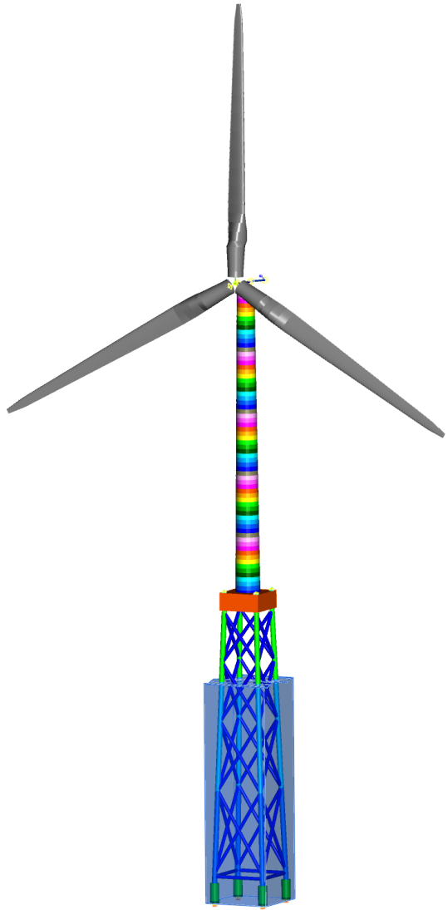
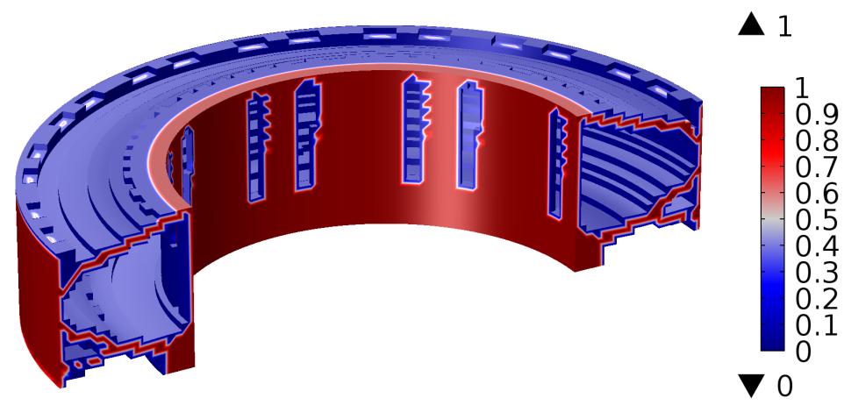
Topology and Shape Optimization in Wind Energy
(Muskulus et al #1326)
(Kirschneck et al #1287)

Slide 30
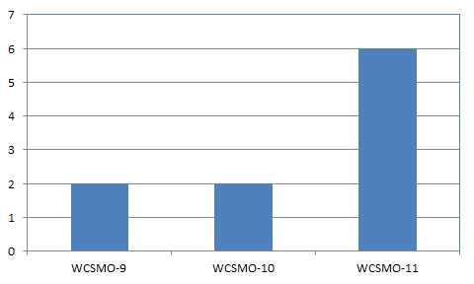
Topology and Shape Optimization for Energy Harvest
#1212 Lee, Yoon, Topology optimization of vibration energy harvesters using electromagnetic induction
#1309 Guedes et al, Piezoelectric Material Tailoring for Vibrations Energy Harvesters Power Optimization
#1290 Salas, E Silva et al, Topology Optimization Applied to the Dynamic Design of the Laminated Piezocomposites Structures (LAPS) Used for purposes of Energy Harvesting
#1269 Yoon, BD Youn et al, System reliability analysis of piezoelectric energy harvester under various physical uncertainties

Slide 31
Agenda
Topology and shape optimisation in recent WCSMO.
Algorithmic aspects
Stress criteria
Thermofluids
Multiscale problems
Metamaterials
Energy harvest (wind, solar, radiation etc)
Biomedical engineering
Additive manufacturing

Slide 32
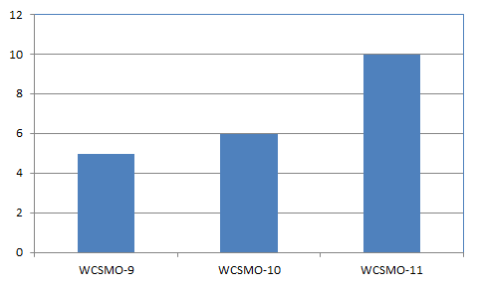
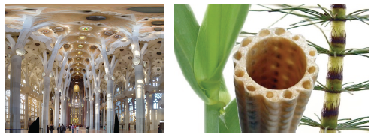
Topology/shape optimization for biological/biomedical engineering
Soft tissue (viscoelasticity)
Grown plants
Bone prosthetics
Cell sorting
Coronary stent
Vasculature
Dentistry
Drug delivery
XFEM based BESO design for all-ceramic dental bridge (min fracture incident)
(Zhang et al #1016)
Architectural structures inspired by natural growth
(Anna-Lena Beger #1323)

Slide 33
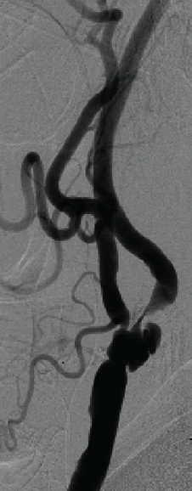
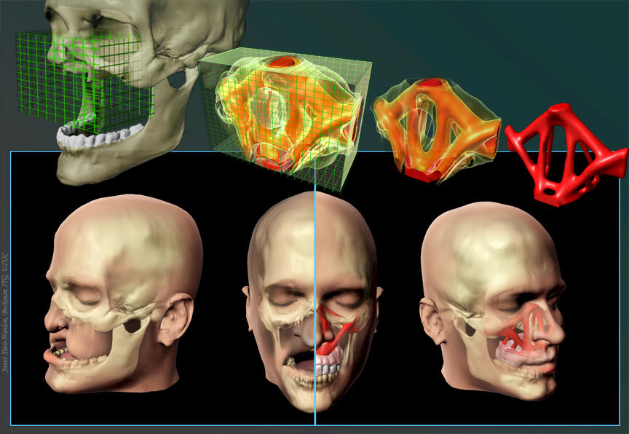
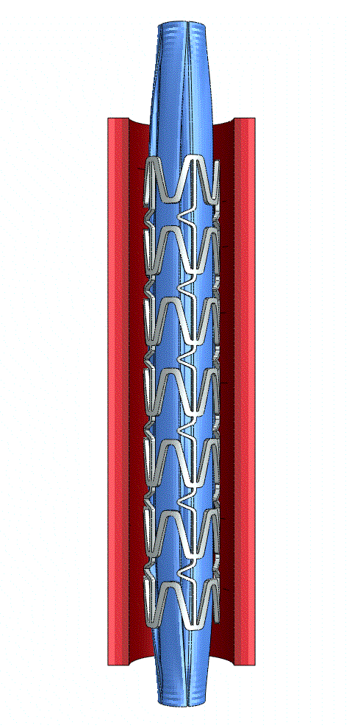
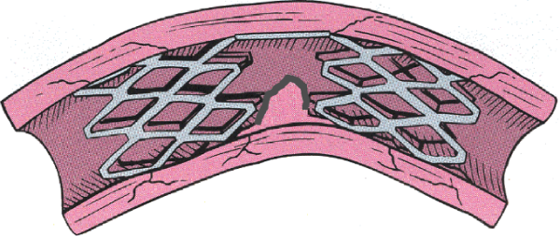
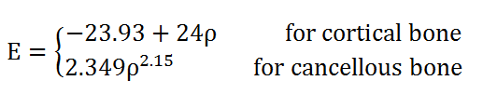
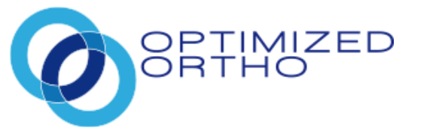
Examples for Biomedical Engineering
From G. Pauline
(Tammareddi et al #1456)

Slide 34
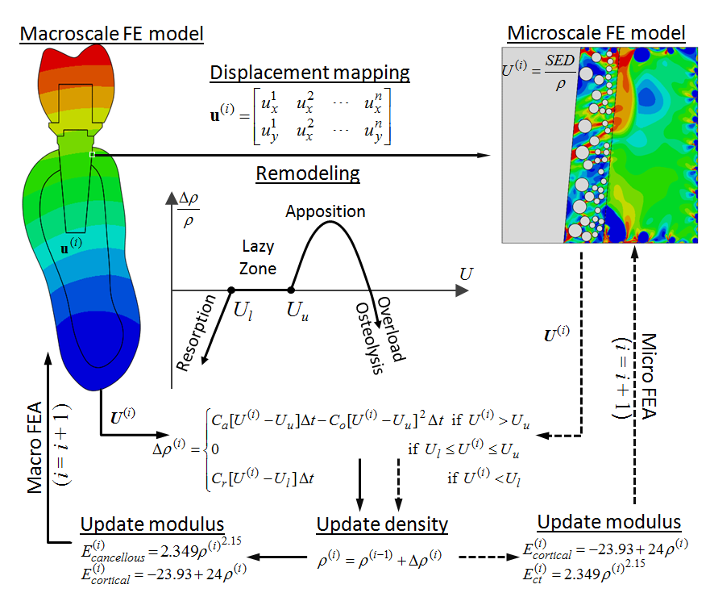
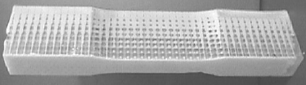
Multiscale - bone remodelling for implant optimization
(Markworth et al 1995)
inner loop for bone remodelling
Outer loop for topology optimization
(Chen et al #1028)

Slide 35
Agenda
Topology and shape optimisation in recent WCSMO.
Algorithmic aspects
Stress criteria
Thermofluids
Multiscale problems
Metamaterials
Energy harvest (wind, solar, radiation etc)
Biomedical engineering
Additive manufacturing

Slide 36
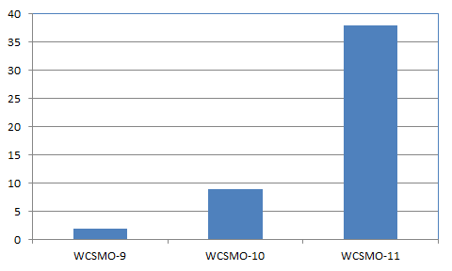
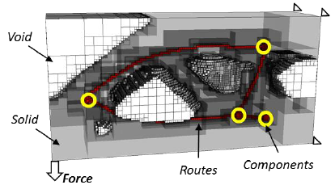



Additive manufacturing for topology/shape optimisation
(Panesar et al #1103)
Material dependent shrinkage
Residual stress
Resolution and accuracy
... New science?
3D metamaterials
3D nanomaterials
(Xie et al #1197)
NanoScribe 3D printer

Slide 37
Conclusion
Open for discussion and input …

Slide 38

.
.
Thanks!
.
Cairns
Townsville
.
Brisbane
.
Contact Details:
Professor Qing Li
School of Aerospace, Mechanical and Mechatronic Engineering
The University of Sydney,
NSW 2006, Australia
Email: Qing.Li@Sydney.edu.au
Tel: +61-2-9351 8607
.
Sydney
Melbourne

